Slide 1

Bioinformatics Bootcamp
Intro to Python for Biomedical Machine Learning
PART I: Python for Data Science
Module 1: Orientation and Intro to Python

Slide 2
Workshop Orientation

Slide 3
Why a workshop?

Slide 4
Why a workshop?
Those who know programming/bioinformatics will be…

Slide 5
Why a workshop?
Those who know programming/bioinformatics will be…
More effective at research

Slide 6
Why a workshop?
Those who know programming/bioinformatics will be…
More effective at research
More competitive for jobs/funding

Slide 7
Why a workshop?
Those who know programming/bioinformatics will be…
More effective at research
More competitive for jobs/funding
More flexible/adaptable to changes in their field

Slide 8
Why a workshop?
Those who know programming/bioinformatics will be…
More effective at research
More competitive for jobs/funding
More flexible/adaptable to changes in their field
There is tremendous interest in formal bioinformatics training... yet, opportunities for such training are sparse.

Slide 9
Why a workshop?
Those who know programming/bioinformatics will be…
More effective at research
More competitive for jobs/funding
More flexible/adaptable to changes in their field
There is tremendous interest in formal bioinformatics training... yet, opportunities for such training are sparse.
Solution: Provide workshops open to all!

Slide 10
But most of all…

Slide 11
Machine learning!

Slide 12
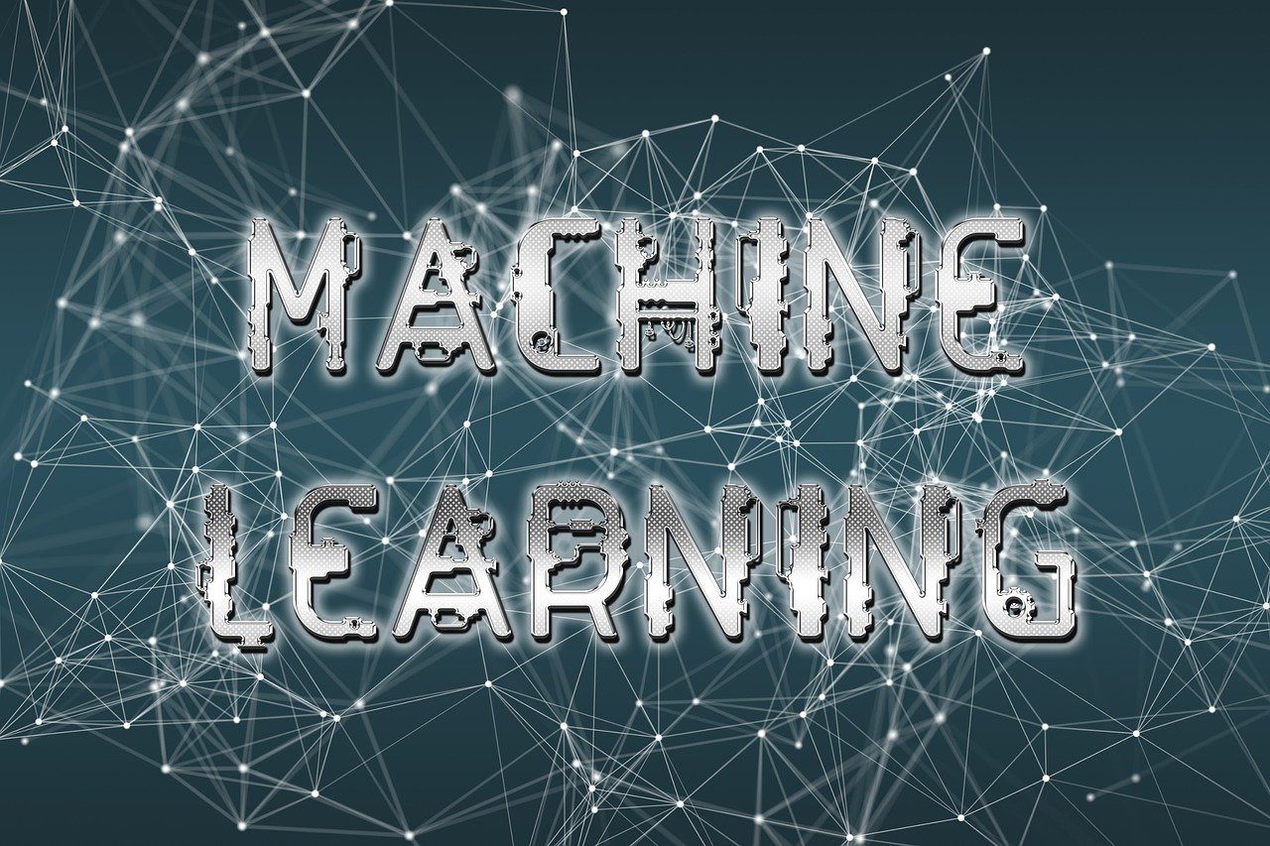
https://cdn.pixabay.com/photo/2019/04/15/12/09/machine-learning-4129175_1280.jpg

Slide 13
Workshop Structure
Most sessions will be roughly 2:1 lecture and hands-on activities.

Slide 14
Workshop Structure
Most sessions will be roughly 2:1 lecture and hands-on activities.
***Lectures will be recorded***

Slide 15
Workshop Structure
Most sessions will be roughly 2:1 lecture and hands-on activities.
***Lectures will be recorded***
Post questions in the chat

Slide 16
Workshop Structure
Most sessions will be roughly 50:50 lecture and hands-on activities.
***Lectures will be recorded***
Post questions in the chat
Outline
PART I: Python for Data Science
PART II: Intro to Biomedical Machine Learning

Slide 17
Workshop Structure
Most sessions will be roughly 50:50 lecture and hands-on activities.
***Lectures will be recorded***
Post questions in the chat
Outline
PART I: Python for Data Science
PART II: Intro to Biomedical Machine Learning

Slide 18
Part I: Python for Data Science
Module #1: Intro to Python Programming
Module #2: Intermediate Python
Module #3: Python for Data Science
Module #4: Review week

Slide 19
Workshop Structure
Most sessions will be roughly 50:50 lecture and hands-on activities.
***Lectures will be recorded***
Post questions in the chat
Outline
PART I: Python for Data Science
PART II: Intro to Biomedical Machine Learning

Slide 20
Workshop Structure
Most sessions will be roughly 50:50 lecture and hands-on activities.
***Lectures will be recorded***
Post questions in the chat
Outline
PART I: Python for Data Science
PART II: Intro to Biomedical Machine Learning

Slide 21
Part I: Python for Data Science
Module #1: Intro to Python Programming
Module #2: Intermediate Python
Module #3: Python for Data Science
Module #4: Review week

Slide 22
Learning goals and objectives
From this workshop, you will learn the following topics:
Data structures
Plotting
Reading/writing files
Conditional logic & control flow
Function definitions
Data processing pipelines with tidyverse

Slide 23
Learning goals and objectives
From this workshop, you will learn the following topics:
Data structures
Plotting
Reading/writing files
Conditional logic & control flow
Function definitions
Data processing pipelines with tidyverse
By the end, you will gain the skills and confidence to use R in your research.

Slide 24
How to succeed in this workshop

Slide 25
How to succeed in this workshop
Complete the assignments in DataCamp

Slide 26
How to succeed in this workshop
Complete the assignments in DataCamp
Pursue outside learning (e.g., codecademy, RStudio books, etc)

Slide 27
How to succeed in this workshop
Complete the assignments in DataCamp
Pursue outside learning (e.g., codecademy, RStudio books, etc)
Communicate with your instructors
Email any time and attend Zoom office hours (listed in the syllabus)

Slide 28
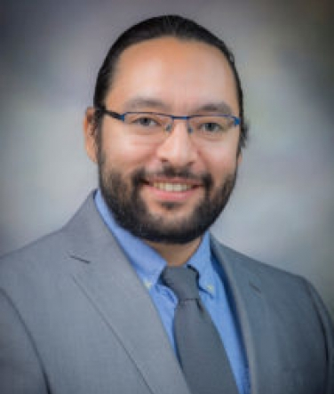
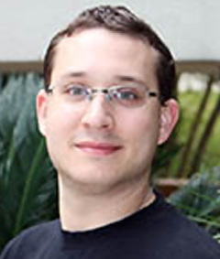

Meet your instructors
Daniel Montemayor, PhD
Assistant Professor
Center for Renal Precision Medicine
Department of Medicine
Simon Levy
5th-year PhD Student
Bess Frost Laboratory
Henry Miller
3rd-year PhD Student
Alex Bishop Laboratory

Slide 29

About BIG club
Bioinformatics Interest Group (BIG) is a new UT Health SA club promoting student engagement with bioinformatics.
Leadership
President: Muku Bhandari
Vice President: Victoria Alers
Secretary: Paul Ramirez
Training committee chair: Henry Miller
Historian: Aiola Stoja
Treasurer: Meilinn Tram
All UT Health SA students are welcome to join our next meeting Tomorrow from 6:30-7:30pm CST.

Slide 30
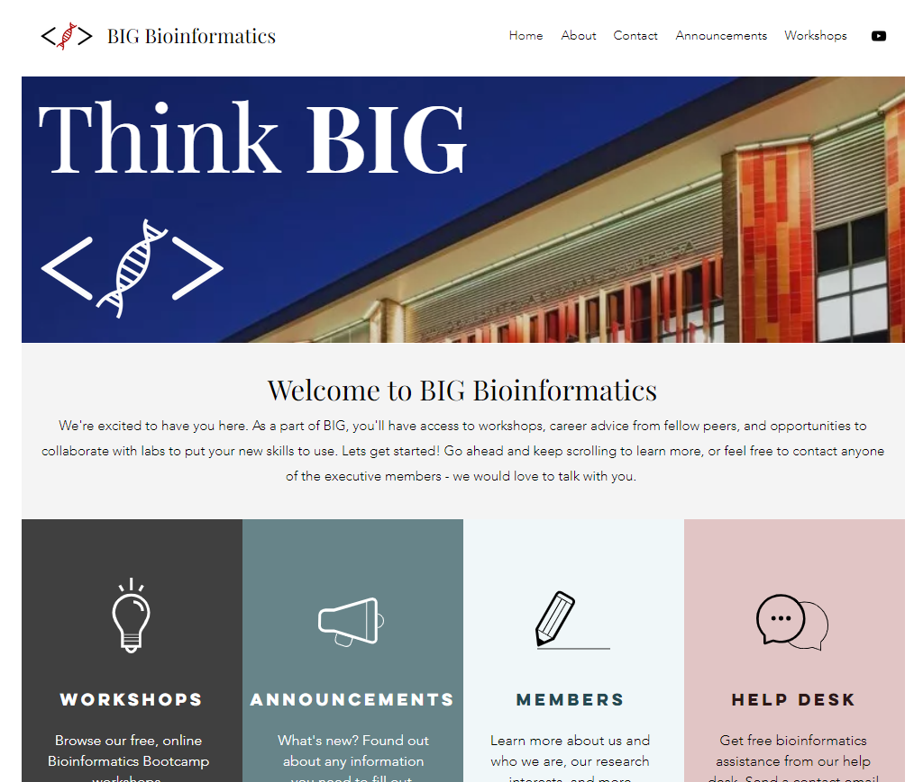
https://www.bigbioinformatics.org/

Slide 31
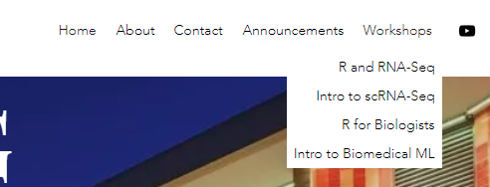
https://www.bigbioinformatics.org/

Slide 32
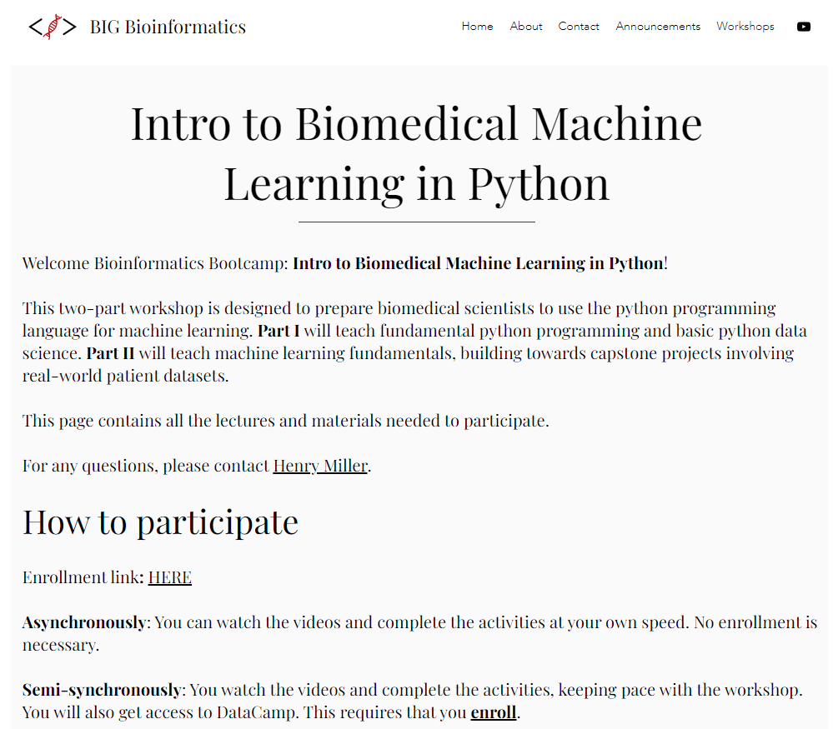
https://www.bigbioinformatics.org/

Slide 33
Introduction
Why should you learn machine learning?

Slide 34
https://cdn.pixabay.com/photo/2019/04/15/12/09/machine-learning-4129175_1280.jpg

Slide 35
What we typically do in basic science: Exploratory Data Analysis

Slide 36
Typical biology / bioinformatics workflow
Have a biological question / problem
Generate a hypothesis / solution
Do exploratory analysis
Do confirmatory experiments
Publish

Slide 37
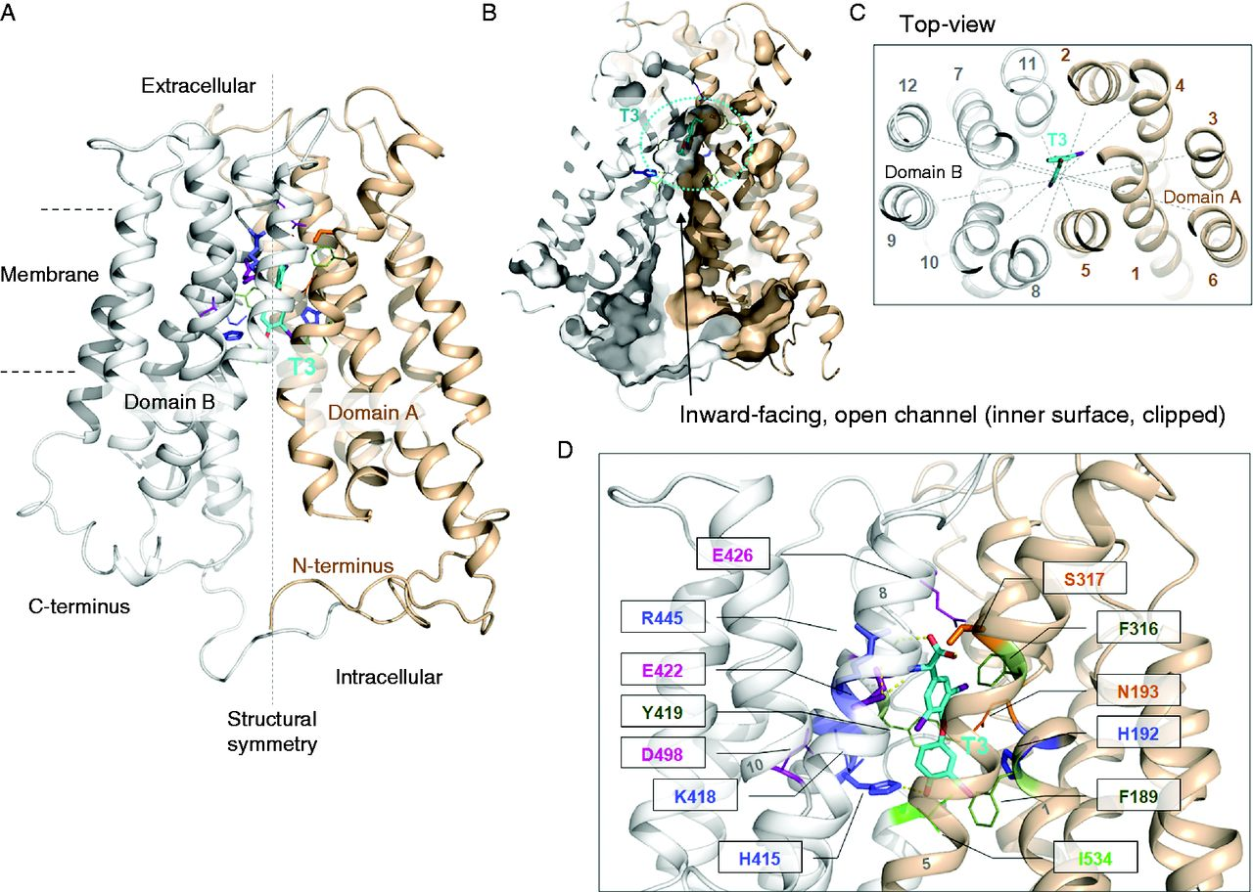
SLC16A2
Fischer J., et al. Modulation of monocarboxylate transporter 8 oligomerization by specific pathogenic mutations. Journal of Molecular Endocrinology. 2015, 54(1):39-50. PubMed ID: 25527620

Slide 38
:(
Fischer J., et al. Modulation of monocarboxylate transporter 8 oligomerization by specific pathogenic mutations. Journal of Molecular Endocrinology. 2015, 54(1):39-50. PubMed ID: 25527620

Slide 39


X

Slide 40
X
☺

Slide 41

…?

Slide 42
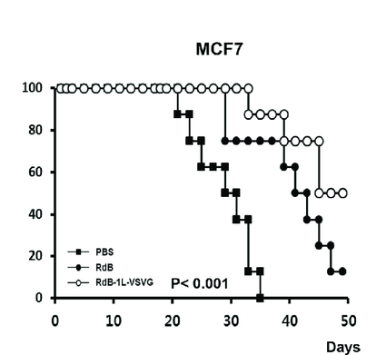

Slide 43
Get the protocol approved
> 2-3 weeks
Get the mice
> 2-3 weeks
Inject & monitor survival
> 8 weeks

Slide 44
…?

Slide 45
> 12-14 weeks

Slide 46
> 12-14 weeks ☹

Slide 47
?

Slide 48
Gepia2 Demo

Slide 49
:(
Fischer J., et al. Modulation of monocarboxylate transporter 8 oligomerization by specific pathogenic mutations. Journal of Molecular Endocrinology. 2015, 54(1):39-50. PubMed ID: 25527620

Slide 50
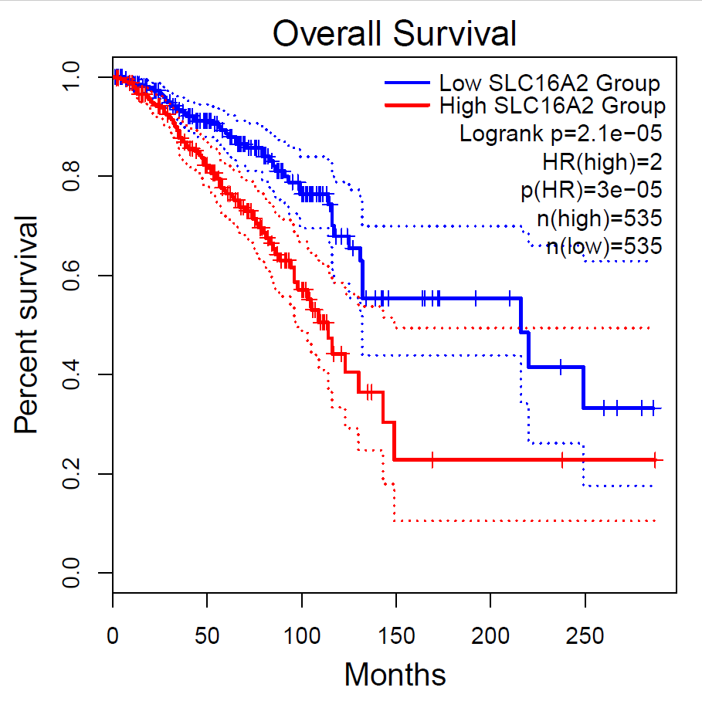

Slide 51
:(
Probably…
Fischer J., et al. Modulation of monocarboxylate transporter 8 oligomerization by specific pathogenic mutations. Journal of Molecular Endocrinology. 2015, 54(1):39-50. PubMed ID: 25527620

Slide 52
> 12-14 weeks

Slide 53
> 12-14 weeks ☺

Slide 54
:(
How do I use this knowledge?
Can this be used to save lives?
Can I go further with this and get a higher impact paper?
Want to build a model that reveals aspects of biology.
Fischer J., et al. Modulation of monocarboxylate transporter 8 oligomerization by specific pathogenic mutations. Journal of Molecular Endocrinology. 2015, 54(1):39-50. PubMed ID: 25527620

Slide 55
What if we could use this information to save lives?

Slide 56
:(
Fischer J., et al. Modulation of monocarboxylate transporter 8 oligomerization by specific pathogenic mutations. Journal of Molecular Endocrinology. 2015, 54(1):39-50. PubMed ID: 25527620

Slide 57
Hard to predict
:(
Fischer J., et al. Modulation of monocarboxylate transporter 8 oligomerization by specific pathogenic mutations. Journal of Molecular Endocrinology. 2015, 54(1):39-50. PubMed ID: 25527620

Slide 58
Easy to Measure
Hard to predict
:(
Fischer J., et al. Modulation of monocarboxylate transporter 8 oligomerization by specific pathogenic mutations. Journal of Molecular Endocrinology. 2015, 54(1):39-50. PubMed ID: 25527620

Slide 59
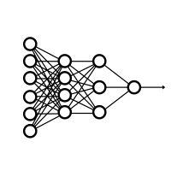


X
Biopsy Tumor
Predict outcomes
Y
Measure expression
(aka, “features”)
Provide personalized care

Slide 60
What is machine learning?

Slide 61
What is ML?
Industrial revolution metaphor?
Resource, not a revolution
Data is the crude oil
Feature engineering is refining
General-purpose problem-solving approach
Survey of tools and the kinds of problems you can answer with them
Preview
Self driving car – image recognition
Precision medicine – biomarkers
Stock market – time series analysis

Slide 62
Workshop workflow

Slide 63
Workshop workflow and beyond…
Basics
Functional Coding
DataSci skills
ML Skills (Prt II)
Predict Leukemia Outcomes project
Computer Vision and Advanced topics

Slide 64
Workshop workflow and beyond…
Basics
Functional Coding
DataSci skills
ML Skills (Prt II)
Predict Leukemia Outcomes project
Electrophysiology Analysis
scRNA-Seq
Protein Interaction network analysis
Drug PK/PD and synergy analysis
Literature Mining
ChIP-Seq / HiC-Seq
Computer Vision and Advanced topics
Structural modeling
Population health
Machine learning
Etc…
Image processing
Clinical data analysis
Things you can do with data science skills in Python

Slide 65
Workshop workflow and beyond…
Basics
Functional Coding
DataSci skills
ML Skills (Prt II)
Predict Leukemia Outcomes project
Computer Vision and Advanced topics

Slide 66
Workshop workflow and beyond…
Basics
Functional Coding
DataSci skills
ML Skills (Prt II)
Predict Leukemia Outcomes project
Computer Vision and Advanced topics

Slide 67



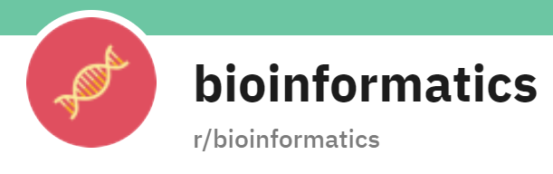


Where to get help

Slide 68
Introduction to Python

Slide 69
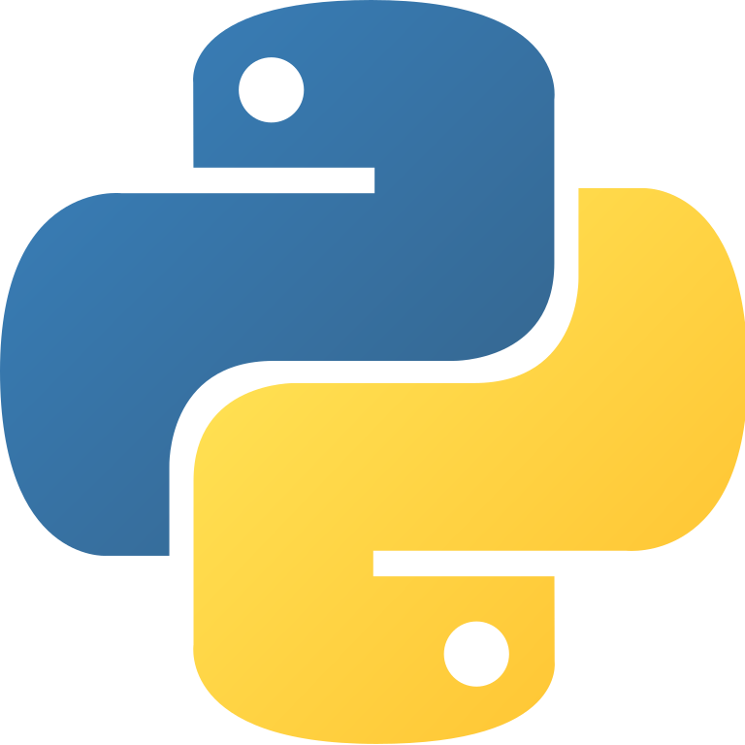
What is Python?
Programming language first released in 1994
Named after Monty Python’s Flying Circus
Features:
Object oriented
Interpreted
Designed for general programming
Easily extended with packages
Called “the glue” because it connects legacy programs together with modern applications

Slide 70
Setting up Python

Slide 71
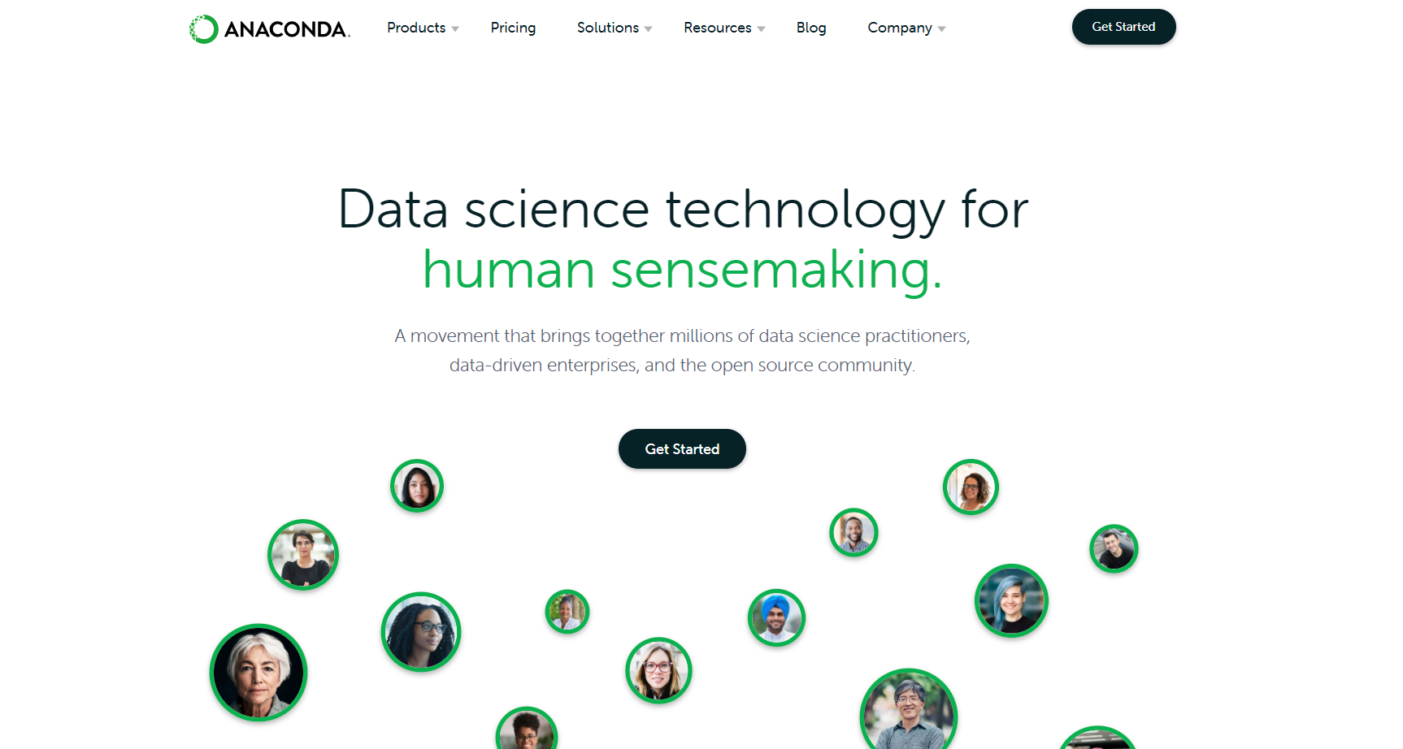

Slide 73
Questions?
Activity: Complete Introductory Python course in DataCamp

